Slide 1
Park Holidays
Reviewing Candidates on Indeed
Updated: 04.10.2021

Slide 2
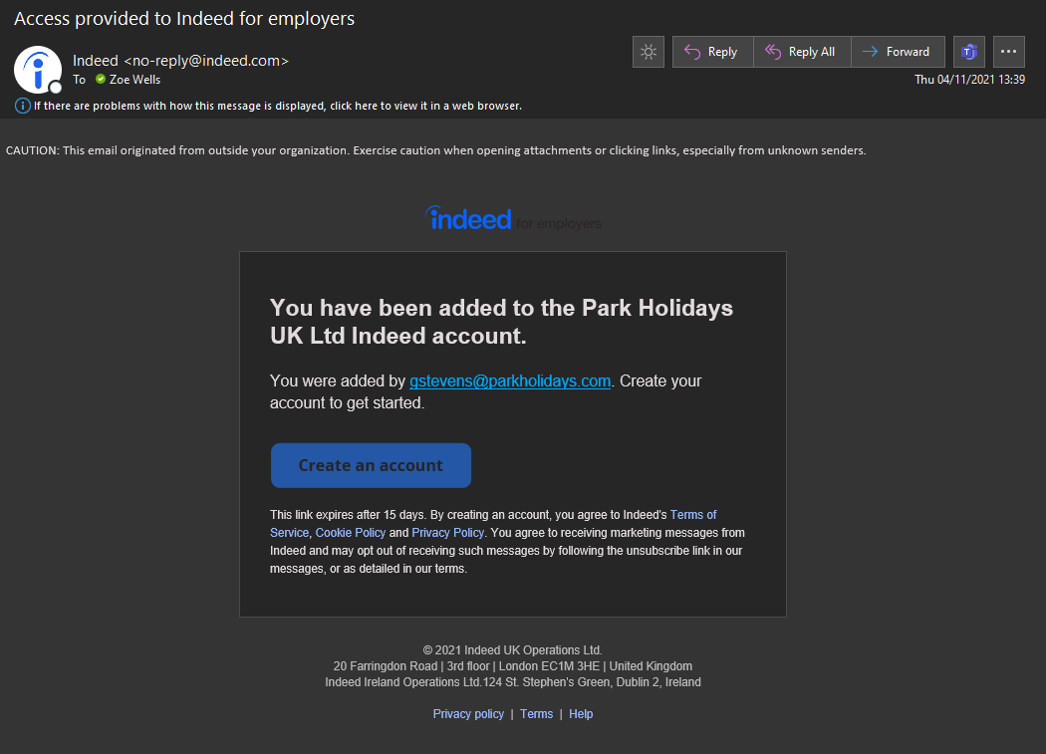
1. Setting up your Indeed Account
First you will need to be added to the Park Holidays Indeed account. Email Recruitment@parkholidays.com to be set up. If you think you may have an account already you can email to ask.
Once you have been added, you will receive an email from Indeed (will likely go to your junk folder)
Once you have received this email-
(If it went to your junk folder, simply move it over to your inbox
to allow you to receive emails from indeed in the future).
Then click on Create an account and follow the steps provided from there.

Slide 3
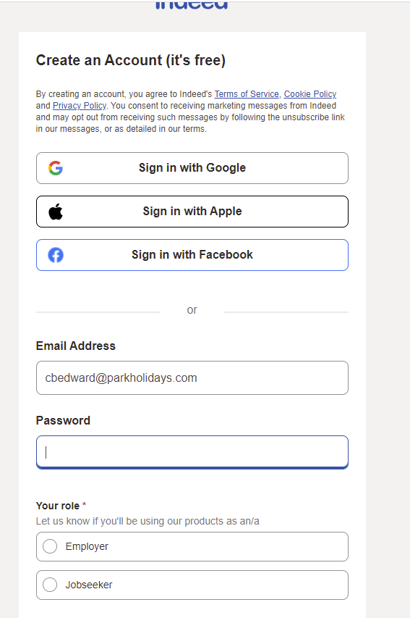
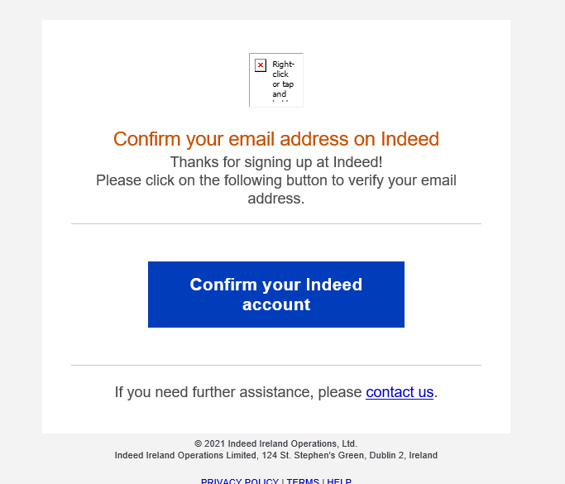
Setting up your Indeed Account
Once you click on Create an account it will take you to Indeed website and ask you to put In your email address and create a new password.
Input your Park Holidays Email address and create your own unique password. (You will need to remember this yourself-as it is your own individual log in).
Select Employer as your role.
Once you have done this- check your inbox and you will have received an email from Indeed asking you to confirm your account.
Simply click the confirm box and this will activate your account.

Slide 4
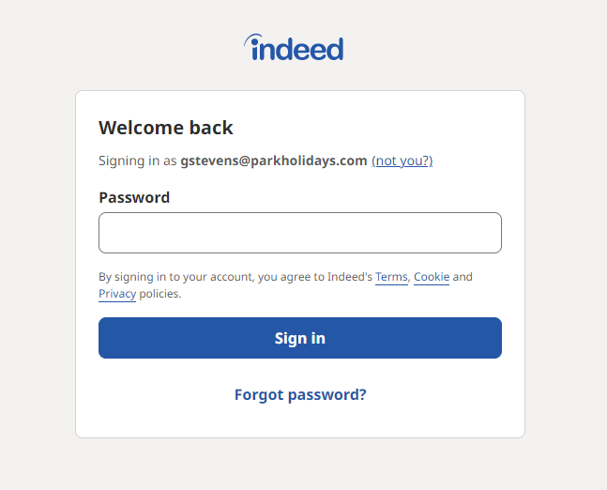
1. Forgot Password
If you are unable to access your account or have forgotten your password. You can select the Forgot Password option. If this continues to not work, please email Recruitment@parkholidays.com
Forgot Password

Slide 5
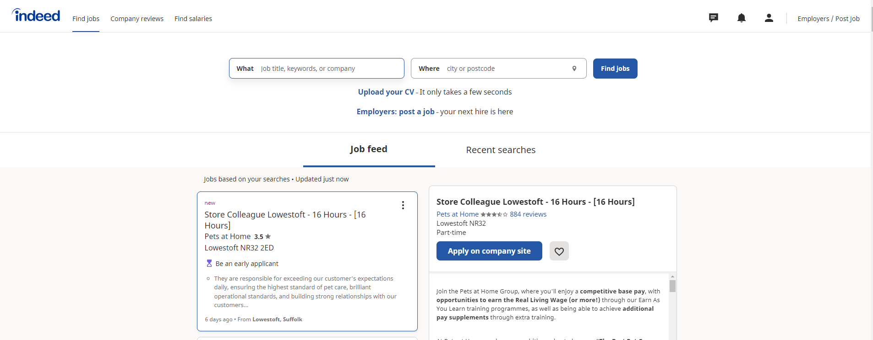
When logging in, you might see this page below...
Setting up your Indeed Account
Make sure to click this option…
This will take you to the Employers page
instead of the Job Search Page

Slide 6
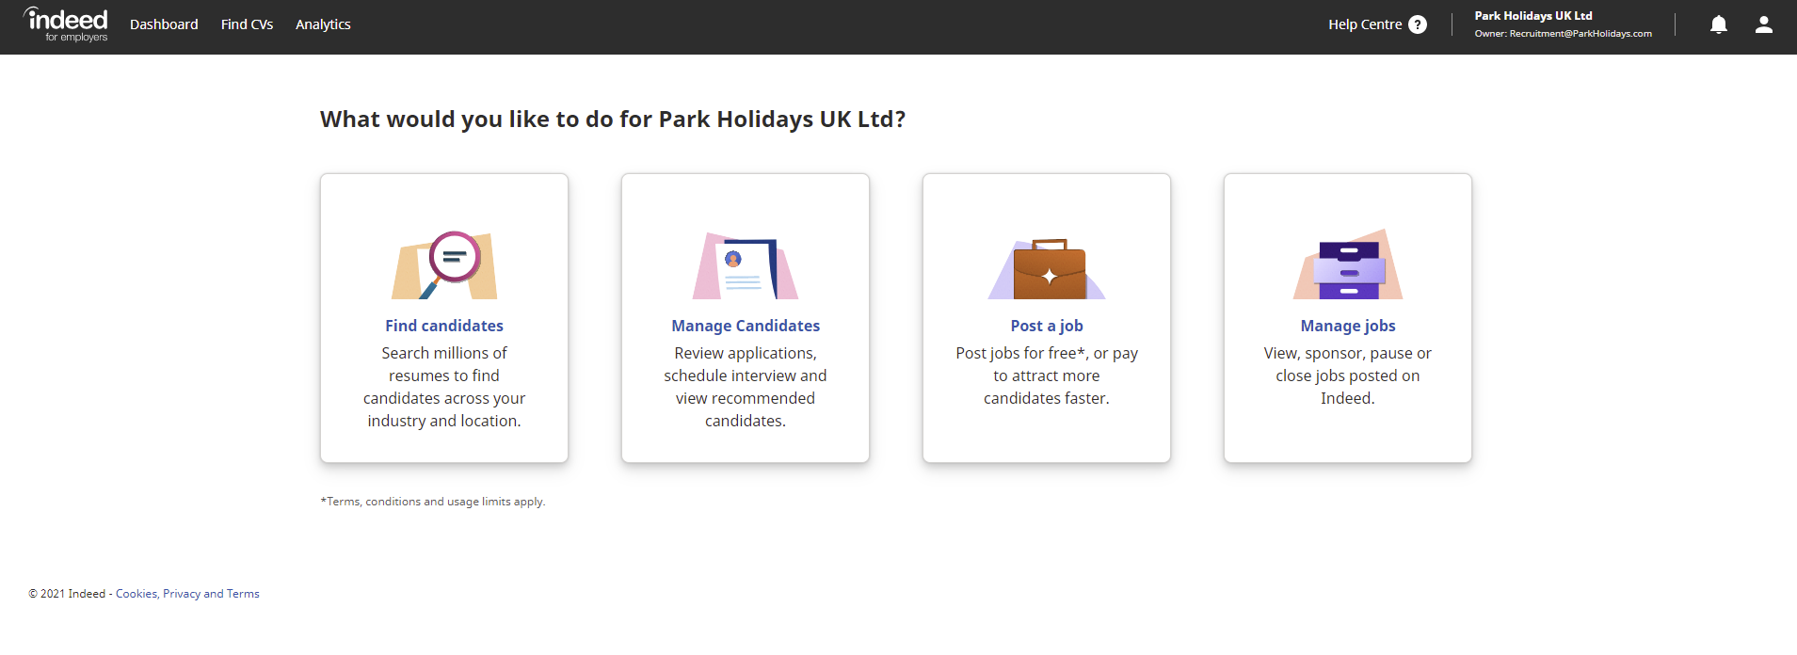
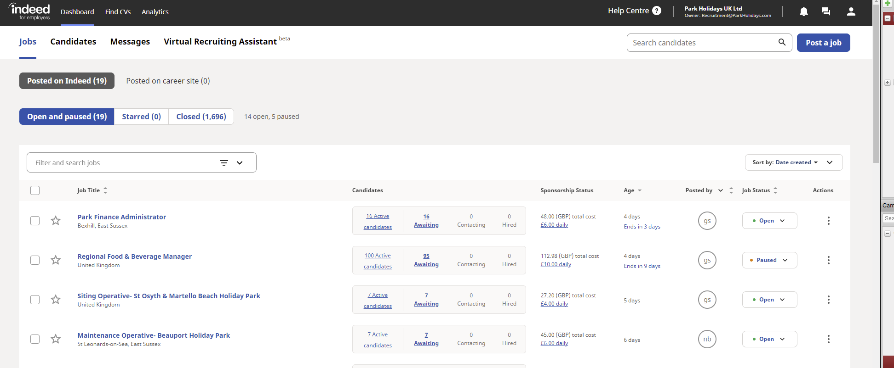
Once you have confirmed your account, you will receive a welcome email from them and a link that will take you to this page.
Setting up your Indeed Account
Here you will be able to manage your jobs and applicants.
It will then take you to your main dashboard. Here you will be able to take a look at your advert and the applicants for it.

Slide 7
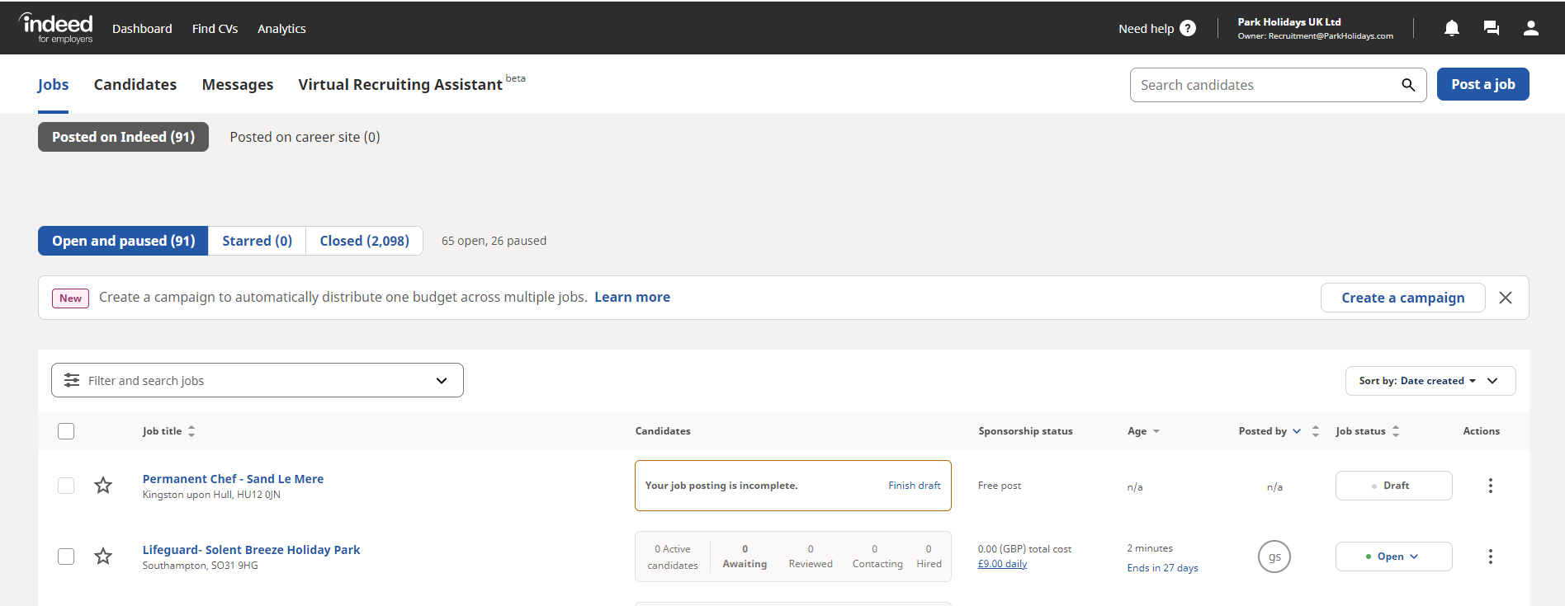
When on the main page make sure you select the Park Holidays UK Ltd account to be allow you to be able to see our Park Holidays jobs and to be able to review the applications etc.
Setting up your Indeed Account

Slide 8
3. Viewing your Applications
Select the Candidates tab at the top of the page.

Slide 9
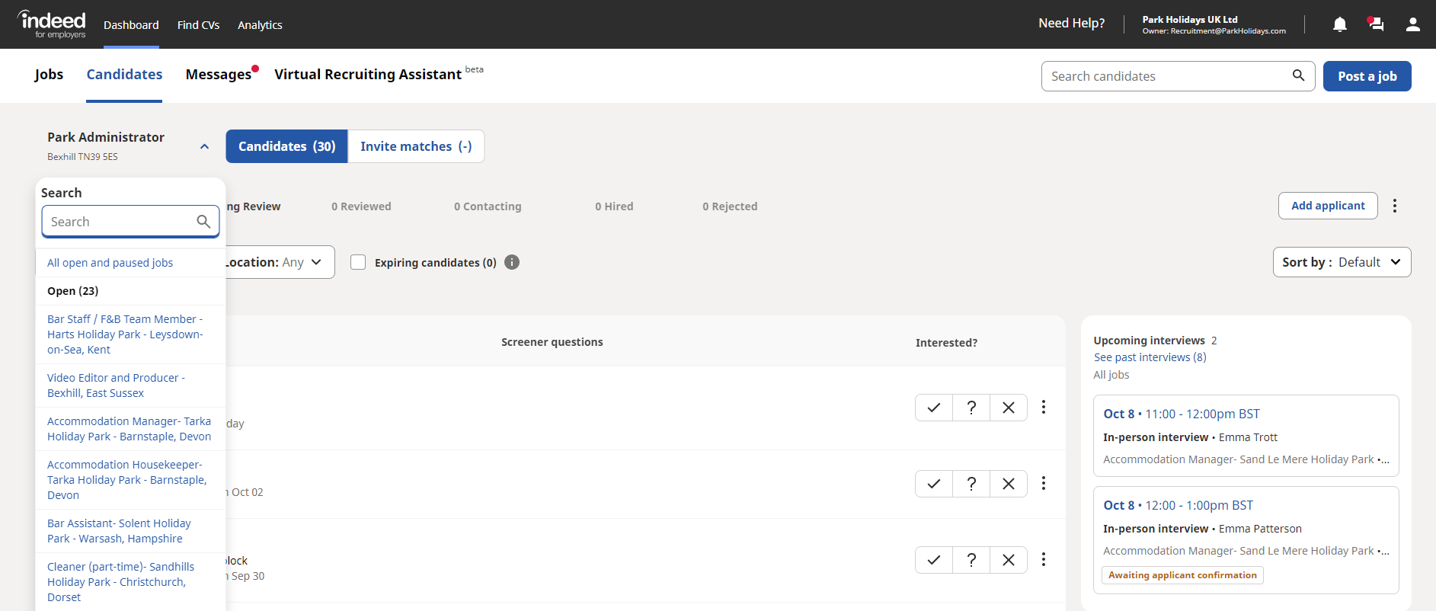
Once you click on Candidates you will see this page. Click on the little arrow next to the job, this will drop down a search for all jobs and allow you to view candidates for other roles.
Once you click on the Job title of the role you are looking for- you will see all the applicants.
Click on the first applicants name and it will bring up their details and CV etc.

Slide 10
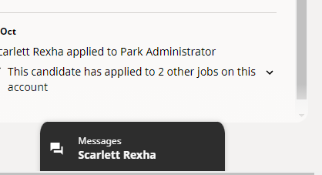
You will then see this page- the applicants details and CV.
Once you have looked at their CV and decided if you are interested in the
applicant or not- you can select yes maybe or no at the interested section.
Selecting No- will automatically send them a rejection email.
You can schedule video interviews, call to arrange an interview or send them a message.
On this same page as above- you will see their name in the bottom right corner.
If you click this, it will then bring up a box that will allow you to message the applicant.
You can then go through the rest of the applicants on the left and do the same steps as above.

Slide 11
You can change the status of the job on the main dashboard.
If you want to pause the advert for a while- so you can review applicants etc. Select here and change to pause.
Do the same to open, close and pause the advert.

Slide 12
Help
If you have any issues or questions on how to use the Indeed Platform please contact:
Recruitment@parkholidays.com
HR Team
Gstevens@parkholidays.com
Agomes@parkholidays.com

